Slide 1
Hierarchical Clustering
Unsupervised Learning

Slide 2
In this session...
In the last session, we studied the K-means algorithm to cluster the dataset
In K-means, the clusters are mostly in spherical shape. Also we need to provide number of clusters (K) to the algorithm
In this session, we study another clustering technique: Hierarchical clustering.
In this algorithm there is no need to pre-specify the number of clusters
The DBSCAN algorithm can form clusters of any arbitrary shape and it is robust to outliers

Slide 3
Hierarchical clustering
Hierarchy based clustering method
Two main types: Agglomerative (bottom to top approach) and Divisive (top to bottom approach)
No need to pre-define the number of clusters

Slide 4
Agglomerative clustering
Most popular hierarchical clustering method
It considers the bottom to top approach
The similar observations are clustered together to form a bigger cluster, considering each observation as a unique cluster in the initial step
The process continues till all the observations are fused in a single cluster
A dendrogram is used to visualize such cluster formation

Slide 5
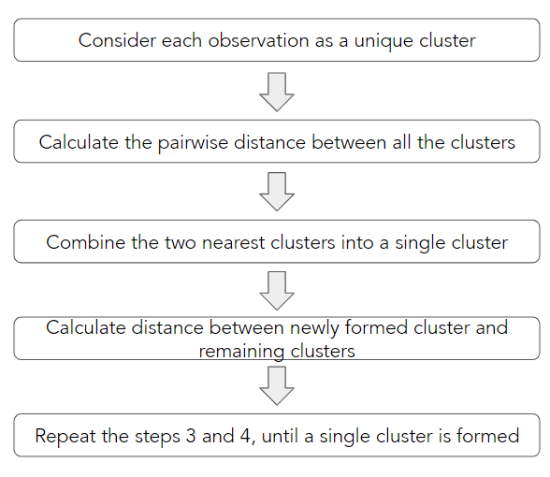
Agglomerative clustering - procedure

Slide 6
Distance matrix
In the initial step of clustering, each observation is considered as a cluster
The distance matrix returns the pairwise distance between all these observations
The pairwise distance can be calculated using various distance measures like Manhattan, Euclidean, Minkowski and so on
This matrix is used to find the two closest clusters

Slide 7
Question:
Find the distance matrix for the given data using Euclidean distance.
 | X | Y
A | 0.1 | 0.4
B | 0.25 | 0.32
C | 0.29 | 0.19

Slide 8

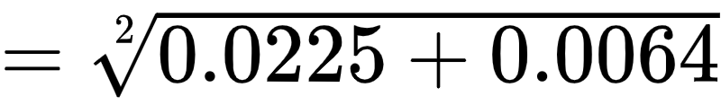
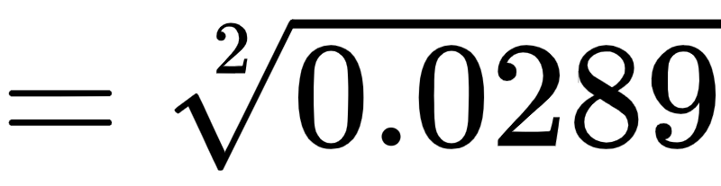
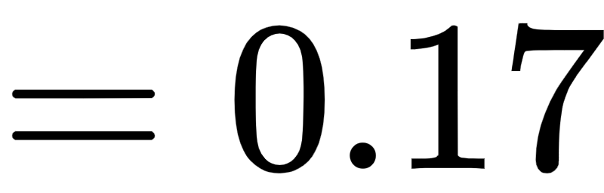
Answer:
To obtain a distance matrix, calculate the Euclidean distance between all the points.
 | X | Y
A | 0.1 | 0.4
B | 0.25 | 0.32
C | 0.29 | 0.19
The distance between data points A and B is 0.17. Similarly we can calculate the distance between all the points.

Slide 9
Answer:
By calculating all the distances, we obtain the distance matrix. This matrix returns all the pairwise distances.
 | A | B | C
A | 0 | 0.17 | 0.28
B | 0.17 | 0 | 0.14
C | 0.28 | 0.14 | 0

Slide 10
Distance matrix
The distance of a point from itself will always be zero
Thus, the diagonal of the distance matrix will be zero
Here, we have 3x3 matrix for 3 clusters, as each point is considered as a cluster
We have to group these clusters such that at the end we are left with a single cluster that consists of all the observations
 | A | B | C
A | 0 | 0.17 | 0.28
B | 0.17 | 0 | 0.14
C | 0.28 | 0.14 | 0

Slide 11
Distance matrix
In each iteration, our goal is to find the closest pair
Here we can see that the distance between the points B and C is the minimum
Thus, we group B and C in one cluster (B, C)
 | A | B | C
A | 0 | 0.17 | 0.28
B | 0.17 | 0 | 0.14
C | 0.28 | 0.14 | 0

Slide 12
Distance matrix
We will have to update the distances in the distance matrix
The distance between the ungrouped clusters/elements will remain the same
But, how we will calculate the distance between the ungrouped clusters and the newly created cluster (B, C)?
Here is where the different linkage methods are used

Slide 13
Linkage methods
Similarity between the clusters (inter-cluster distance) can be measured using various types of linkages
Some of the types are: Single, Complete, Average, Centroid linkage

Slide 14
Single linkage
It is defined as the minimum distance between the points of two clusters.
The method can create the non-elliptical clusters
It can produce undesirable results in the presence of outliers
It causes a chaining effect, where clusters have merged since at least one point in a cluster is closest to a point in another cluster. This forms a long and elongated cluster
X
Y

Slide 15

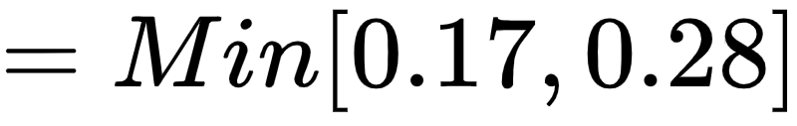
Single linkage
In our example, the single linkage between the cluster (B, C) and A is
 | A | (B, C)
A | 0 | ?
(B, C) | ? | 0
 | A | (B, C)
A | 0 | 0.17
(B, C) | 0.17 | 0

Slide 16
Complete linkage
It is defined as the maximum distance between the points of the two different clusters.
The method returns more stable clusters, with nearly equal diameter
It avoids the chaining effect
It is less sensitive to outliers
It breaks the large clusters and it is biased towards globular clusters
X
Y

Slide 17

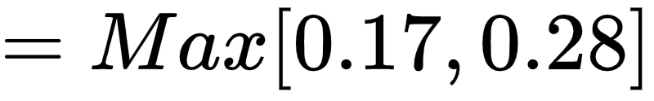
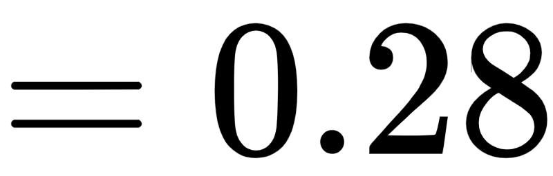
Complete linkage
The complete linkage between the cluster (B, C) and A is
 | A | (B, C)
A | 0 | ?
(B, C) | ? | 0
 | A | (B, C)
A | 0 | 0.28
(B, C) | 0.28 | 0

Slide 18

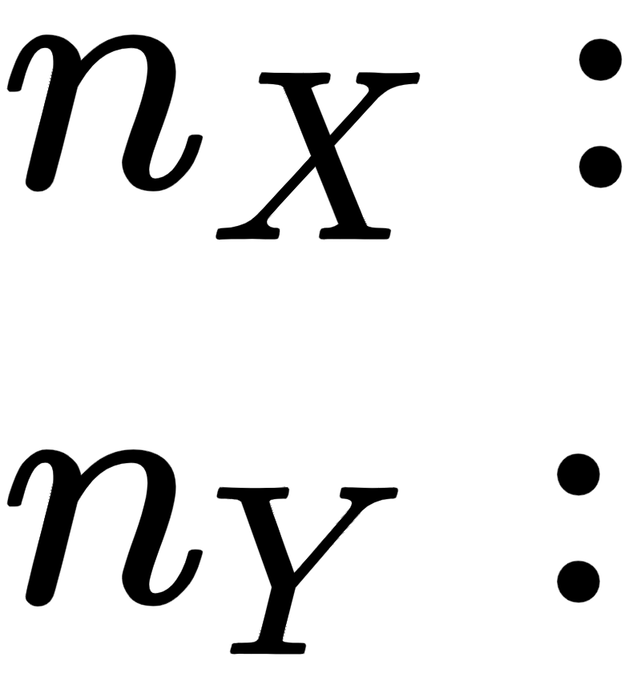
Average linkage
It is defined as the average of all the pairwise distances between the two clusters.
Where,
Number of elements in the cluster X
Number of elements in the cluster Y
X
Y
This method balances between the single and complete linkage
It forms compact clusters and the method is robust to outliers

Slide 19

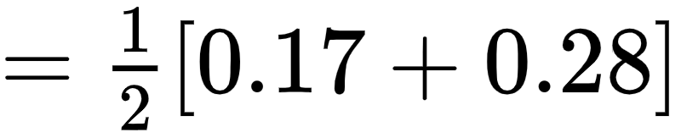
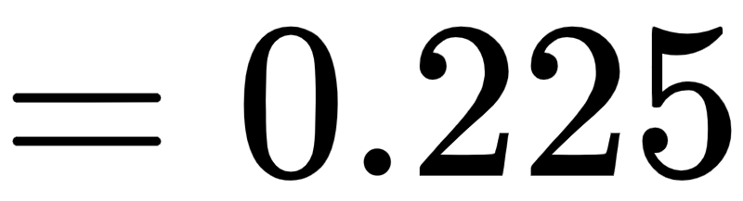
Average linkage
The average linkage between the cluster (B, C) and A is
 | A | (B, C)
A | 0 | ?
(B, C) | ? | 0
 | A | (B, C)
A | 0 | 0.225
(B, C) | 0.225 | 0

Slide 20
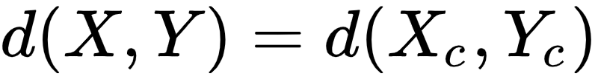
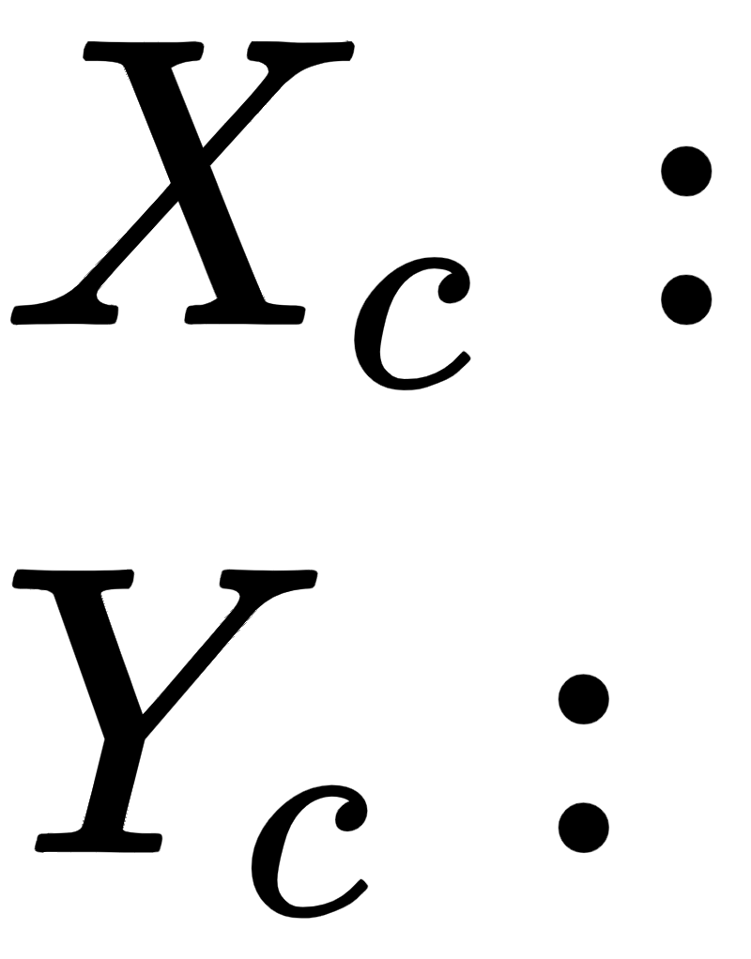
Centroid linkage
It is defined as the distance between the centroids (means) of the two clusters.
Where,
Centroid of the cluster X
Centroid of the cluster Y
X
Y
It creates similar clusters as average linkage
This method suffers a major drawback of inversion. i.e. a smaller cluster can be more similar to the newly merged larger cluster rather than the individual clusters

Slide 21
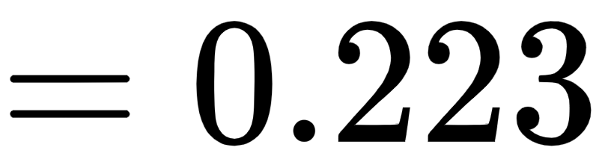
Centroid linkage
The centroid linkage between the cluster (B, C) and A is
 | A | (B, C)
A | 0 | ?
(B, C) | ? | 0
 | A | (B, C)
A | 0 | 0.223
(B, C) | 0.223 | 0

Slide 22
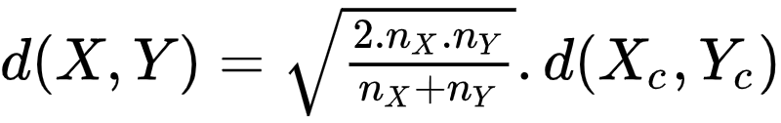
Ward Linkage (ward minimum variance method)
By default, the scikit-learn library of python considers the ‘ward’ linkage
The clusters are merged; if the new cluster minimizes the variance
It is a computationally intensive method
It is given by the formula:
and
Centroid of the cluster X
Number of elements in the cluster X
Centroid of the cluster Y
Number of elements in the cluster Y

Slide 23
Dendrogram
It is a very useful technique to visualize the clusters
It is a tree-based hierarchical structure that can be used to decide the required number of clusters
Different linkage methods result in the formation of different dendrograms
Observations linked at a low height represents more similar observations
Dissimilar observations fuse at a higher level in the dendrogram

Slide 24
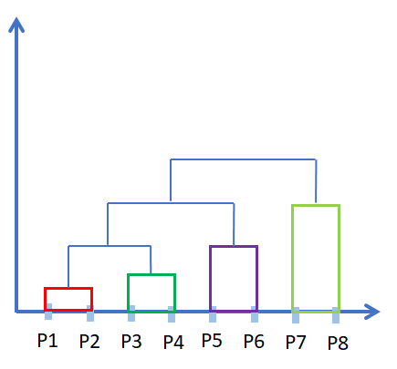
Dendrogram
X-axis of the dendrogram represents the data point, each considered as a single cluster and the distance is given on the Y-axis
Each single cluster is known as ‘leaf’
The horizontal line is known as ‘clade’ which represents the merging of clusters
Distance
Observations

Slide 25
Dendrogram
P1 and P2 are clustered at the lowest height, which implies more similarity between the observations
The clusters (P1, P2) and (P3, P4) are clustered to form a bigger cluster. Then this cluster is fused with (P5, P6) to form a even bigger cluster
Finally, this cluster is fused with (P7, P8) to form a single cluster
Distance
Observations

Slide 26
Cutting the dendrogram
The number of clusters depends on the height at which the dendrogram is cut
Cutting the dendrogram at different heights results in the formation of distinct clusters
The optimal number of clusters is the number that remains constant for the larger distance on the y-axis
Distance
Observations

Slide 27
Dendrogram
The black line shows the height at which the dendrogram is being cut
This line intersects the dendrogram at 4 distinct points, which gives 4 clusters namely (P1, P2, P3, P4), (P5, P6), P7, and P8
The clusters P7 and P8 are clustered at higher distance than the remaining observations, which suggests more dissimilarity between these points
Distance
Observations

Slide 28
Cophenetic correlation coefficient
Quantifies how the dendrogram has represented the dissimilarities between the observations
It is defined as the correlation coefficient between cophenetic distances and the actual distance between the observations
The cophenetic distance between the points P_{i} and P_{j} is the height represented on the Y-axis of dendrogram at which P_{i} and P_{j} are first linked together
The actual distance is the pairwise distance between the observations represented in the distance matrix

Slide 29
Summary
Merits:
Does not require a pre-specified number of clusters
Hierarchical relation between the clusters can be identified
Dendrogram provides a clear representation of clusters
Demerits:
Different dendrograms are produced for different linkage methods
Selecting an optimal number of clusters using dendrogram is sometimes difficult
Time complexity is high

Slide 30
Silhouette score
One of the ways to decide the number of clusters is the silhouette score
We calculate the silhouette score for different values of K (similar to K-means)
The value of K with the highest silhouette score can be considered as an optimal number of clusters

Slide 31
Case Study

Slide 32
Case study: group the data
Consider the data of flower’s petal length and petal width in millimeters for different flowers.
Petal Length | 4.8 | 11 | 5.8 | 10 | 4.6
Petal Width | 8.4 | 9.5 | 8.6 | 9 | 8.8
Can we group the data that belongs to the same kind of flower?

Slide 33
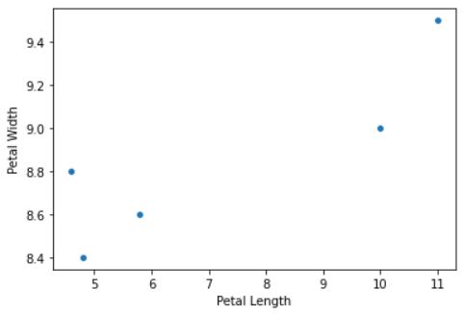
Case study
Use the Euclidean distance as a proximity measure to calculate the distance between the data points.
Use the ‘single’ linkage method to calculate the distance between the two clusters.

Slide 34
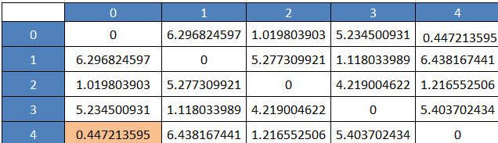
Case study
Calculate the Euclidean distance between the data points.
The distance matrix shows that the first and last points are closest.

Slide 35
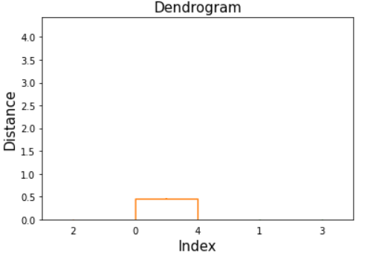
Case study

Slide 36
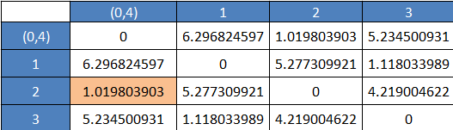
Case study
Consider (0,4) as a new cluster and calculate the distance between the cluster and data points using a single linkage.
Other distances will remain the same.
The distance matrix shows that the 3rd point is closest to the cluster (0,4).

Slide 37
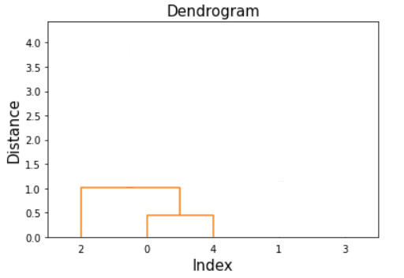
Case study

Slide 38
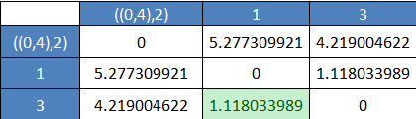
Case study
Consider ((0,4),2) as a new cluster and calculate the distance between the cluster and data points using a single linkage.
Other distances will remain the same.
The distance matrix shows that the 2nd and 4th point are closest to each other.

Slide 39
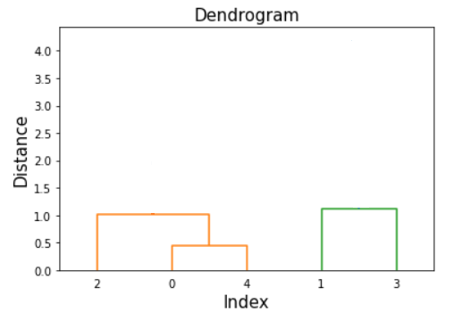
Case study

Slide 40

Case study
Consider (1,3) as a new cluster and calculate the distance between the clusters (1,3) and ((0,4),2) using a single linkage.
Now we have obtained the two clusters. These can be merged into a single cluster.

Slide 41
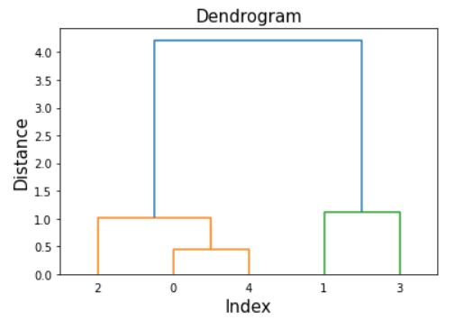
Case study
If we cut the dendrogram at a height of 2.0, then we get two distinct clusters (0,2,4) and (1,3).

Slide 42
Thank You

